Slide 1


AI ENGINEER
HR CLASS

Slide 2
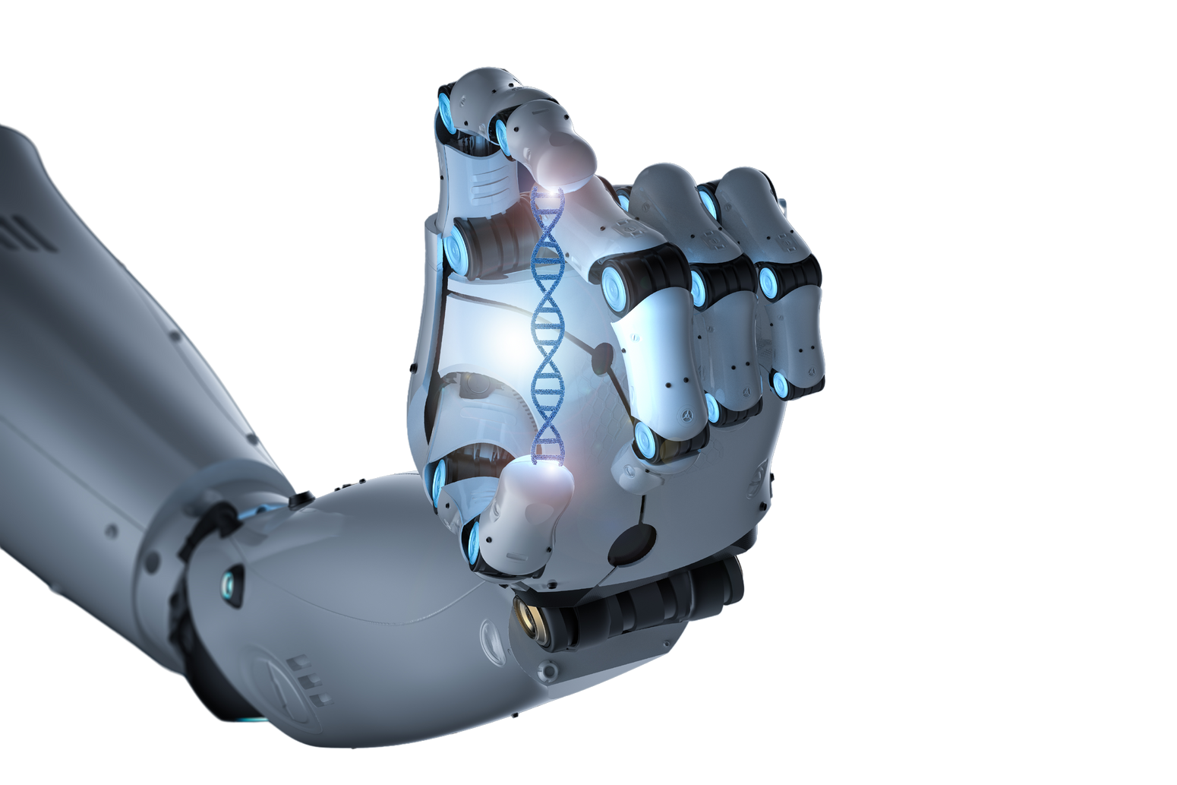
WHAT WILL IT BE ABOUT?
Introduction to AI and its relevance for Romania
Market Insights
What are recruiters looking for
Understand HR expectations on AI Market
Optimize CVs and LinkedIn profiles
Efficient job searching
Prepare effectively for recruitment processes
What next after the HR Class?

Slide 3

What is AI
Artificial Intelligence (AI) refers to the simulation of human intelligence in machines designed to perform tasks such as decision-making, learning, and problem-solving. AI can range from simple automation to complex machine learning systems capable of understanding natural language and processing large datasets.
Key areas of AI include:
Machine Learning (ML): Algorithms that learn from data to make predictions or decisions.
Natural Language Processing (NLP): Enables machines to understand and generate human language.
Computer Vision: Allows machines to interpret and process visual data.
Deep Learning: Advanced neural networks mimicking human brain functionality.

Slide 4
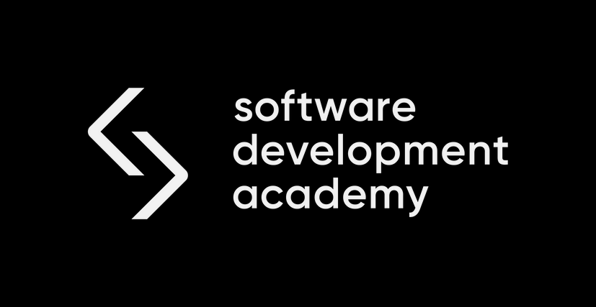

Why Choosing the AI Course is a Great Decision
Future-Proof Your Career: AI and data skills are among the top 10 in-demand skills globally. Learning AI opens doors to high-paying, growth-oriented roles.
Wide Application: AI skills are not limited to IT. Industries like retail, healthcare, and finance are actively recruiting AI professionals.
Be Part of the Change: By studying AI, you’re positioning yourself at the forefront of technological innovation and helping to shape how businesses and societies operate.
Romanian AI Growth Potential: Romania is an emerging hub for AI talent in Eastern Europe, and trained professionals are in high demand.
11%
70%
5%
of employees feels ready to use AI
of jobs will be based on AI
increase of IT sector in Romania in 20025 based on AI

Slide 5


The importance of IT knowledge for your future
AI is not just a technology; it’s a mindset for problem-solving and innovation. The decision to study AI is not just smart - it’s transformative.
rapidly developing technology
integration of AI tools into the work content
growing demand for IT professionals
knowledge of AI tools and IT skills have the same weight today as a university degree 15 years ago.

Slide 6

What is AI Engineer?
Is the mind that develops, program, and trains complex networks forming AI making them function
Like human brains
Build AI models using machine learning algorithms to draw business insights helpful in making organizational-led decisions
Optimization of existing models
Data analysis

Slide 7
The Growing Importance of AI in Romania
Romanian companies are increasingly adopting AI to gain a competitive edge in the global market. Here’s what’s happening:
Automation in Industries: From banking and healthcare to manufacturing, companies use AI to automate routine processes, reducing costs and increasing efficiency.
Demand for AI Skills: The IT job market in Romania has seen a 30% increase in roles requiring AI expertise in the last few years.
Government and Private Sector Support: Initiatives to integrate AI in digital transformation projects across public and private sectors.

Slide 8
Why Companies in Romania Invest in AI
Enhancing Business Insights: AI-powered tools help companies analyze large datasets to uncover trends and make better decisions.
Customer Experience: AI applications such as chatbots and recommendation engines improve customer satisfaction and loyalty.
Global Competitiveness: Romanian firms see AI as a way to stay relevant in international markets where data-driven decision-making dominates.
Workforce Transformation: AI complements human efforts, allowing employees to focus on higher-value tasks.

Slide 9
Companies in Romania already working with AI
NTT DATA Romania
A software services and solutions provider that has showcased AI prototypes, such as 'semantic classification' and the SOTA robot, demonstrating the impact of technology on medicine.
Termene.ro
An online platform that, since 2024, offers AI solutions for comprehensive and rapid analyses of companies and business sectors in Romania.
UiPath
Specializes in robotic process automation (RPA), integrating AI solutions to improve operational efficiency.
Druid
A startup developing intelligent virtual assistants (chatbots) for various industries, utilizing AI technologies to enhance customer interaction.
FintechOS
Provides AI solutions for digitizing and automating financial services, helping institutions improve their offerings to clients.
TARA Interactive
A software development company that has successfully implemented AI solutions for email sorting, chatbot development, transport route optimization, financial data analysis, forecasting, automated offer generation, and supplier interaction automation in the eCommerce industry.
Ascendia
Creates e-learning solutions for various fields—education, employee training, healthcare, entertainment—that can be used in both private and public sectors.
Steepsoft AI
Develops custom AI algorithms that optimize performance and accuracy in various activities, such as predictive analytics or natural language processing.
Questo
Created a platform that allows real-world exploration of tourist attractions through games based on information related to the history and culture of each destination

Slide 10
What salaries can you count on?
Junior
0 - 2 years of experience
Middle
2-4 years of experience
Senior
4+ years of experience
5,000 - 7,000 RON
7,000 - 9,500 RON
9,500 - 15,000 + RON

Slide 11
What are recruiters looking for?
Transferability of Technical and Non-Technical Skills
Transferable skills refer to the technical expertise and soft skills acquired in previous roles or experiences that can be effectively applied to new challenges in AI, enabling seamless integration into the industry.
Technical Skills
Recruiters are looking for candidates with a solid foundation in essential AI and programming skills, such as:
Python programming: Proficiency in using Python for data manipulation, model training, and scripting.
Machine Learning Basics: Understanding supervised and unsupervised learning, and basic algorithms like linear regression, decision trees, and clustering.
Data Processing: Familiarity with tools and libraries such as Pandas, NumPy, and data cleaning methods.
AI Frameworks: Knowledge of TensorFlow, Keras, or PyTorch for building models.
SQL and Databases: Experience in querying and managing data for training machine learning models.
Version Control Systems: Familiarity with Git for collaboration and project management.

Slide 12
What are recruiters looking for?
Non-Technical (Soft) Skills
Soft skills are equally critical for success in a junior AI role:
Problem-Solving: Ability to break down complex problems into smaller, manageable tasks.
Analytical Thinking: Using data-driven approaches to draw insights and inform decisions.
Adaptability: Willingness to learn new tools and methods as the AI field evolves rapidly.
Communication Skills: Explaining technical concepts clearly to non-technical stakeholders.
Teamwork: Collaborating effectively in diverse, cross-functional teams.
Attention to Detail: Ensuring precision in data processing and model training to avoid errors.

Slide 13
Evidence of Continuous Learning
Recruiters value candidates who demonstrate:
Participation in AI courses, certifications, or bootcamps (e.g., Scikit-learn, Coursera AI courses).
Personal projects or contributions to GitHub repositories showcasing hands-on experience.
Attendance at AI/tech meetups, webinars, or conferences.
5. Passion for AI and Problem Solving
Recruiters look for enthusiasm and curiosity about AI's potential to solve real-world challenges. Examples include:
A personal statement in the CV highlighting passion for the field.
Demonstration of initiative, such as experimenting with AI tools or frameworks outside structured training.
What are recruiters looking for?
Evidence of Continuous Learning
Recruiters value candidates who demonstrate:
Participation in AI courses, certifications, or bootcamps (e.g., Scikit-learn, Coursera AI courses).
Personal projects or contributions to GitHub repositories showcasing hands-on experience.
Attendance at AI/tech meetups, webinars, or conferences.
Passion for AI and Problem Solving
Recruiters look for enthusiasm and curiosity about AI's potential to solve real-world challenges. Examples include:
A personal statement in the CV highlighting passion for the field.
Demonstration of initiative, such as experimenting with AI tools or frameworks outside structured training.

Slide 14
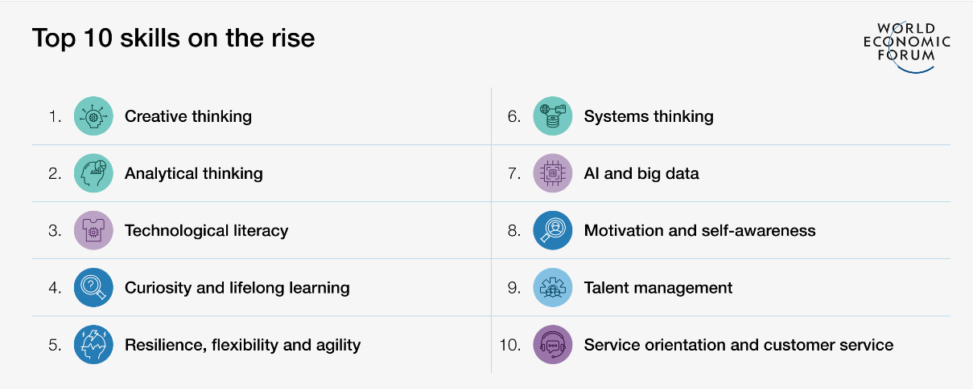
The 10 most in-demand skills in 2025
According to analysts' predictions, AI and big data will be on the top of the charts by 2027.

Slide 15

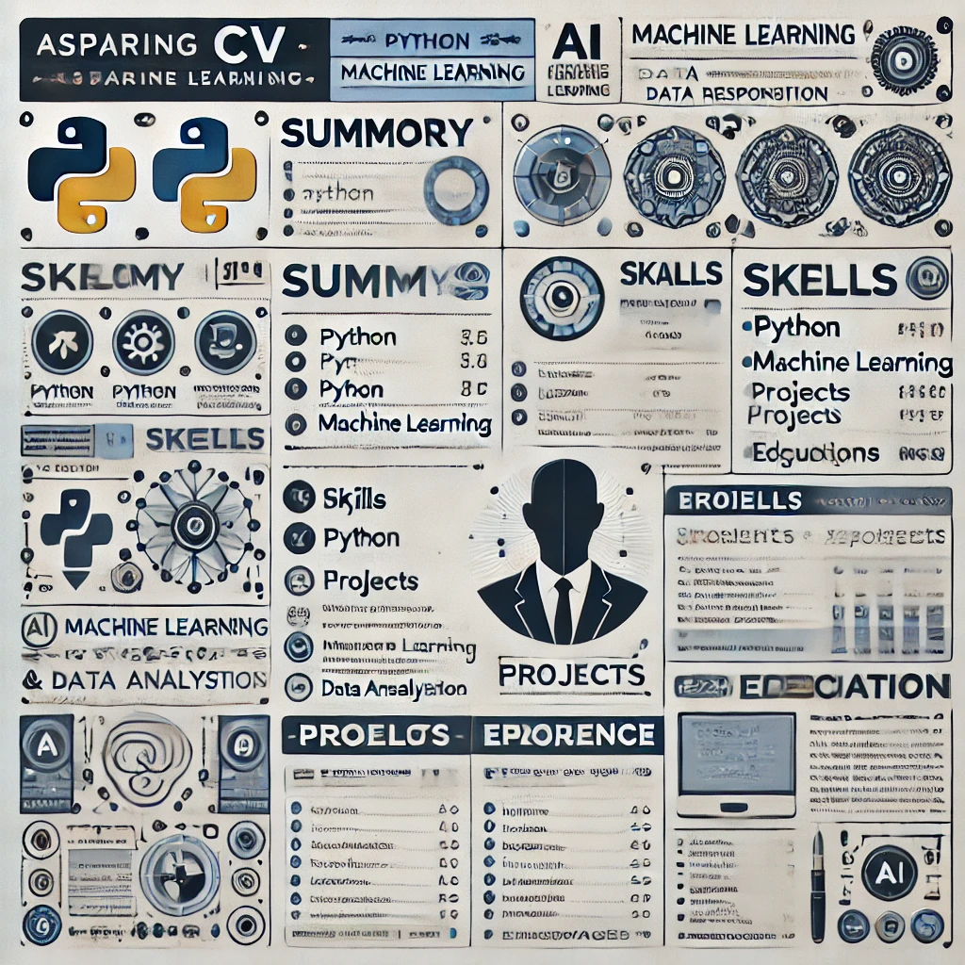

Slide 16

Guideliness for Creating an Effective CV
Keep It Concise: Aim for a CV length of one to two pages. Highlight the most relevant information for the role.
Tailor for the Role: Customize the CV to match the job description, emphasizing skills and experiences that align with the position.
Use a Clear Layout: Organize sections with headers like Contact Information, Summary, Skills, Projects, Experience, Education, and Certifications.
Focus on Achievements: Use bullet points to describe accomplishments, not just duties. Quantify results when possible (e.g., “Improved data analysis speed by 30%”).
Professional Formatting: Use a clean and modern design with consistent fonts, spacing, and neutral colors. Avoid decorative elements.
Keywords: Include industry-specific keywords to optimize the CV for applicant tracking systems (ATS).
Action Verbs: Start bullet points with strong action verbs (e.g., developed, managed, optimized).
Proofread: Ensure there are no spelling or grammar errors. A polished CV reflects attention to detail.
Highlight Projects: Showcase relevant personal or professional projects, especially in technical fields like AI.
Include Certifications: List relevant courses, bootcamps, or certifications (e.g., AI, Python, Data Science).
Professional Summary: Include a short, impactful summary at the top that outlines your career goals and key skills.

Slide 17
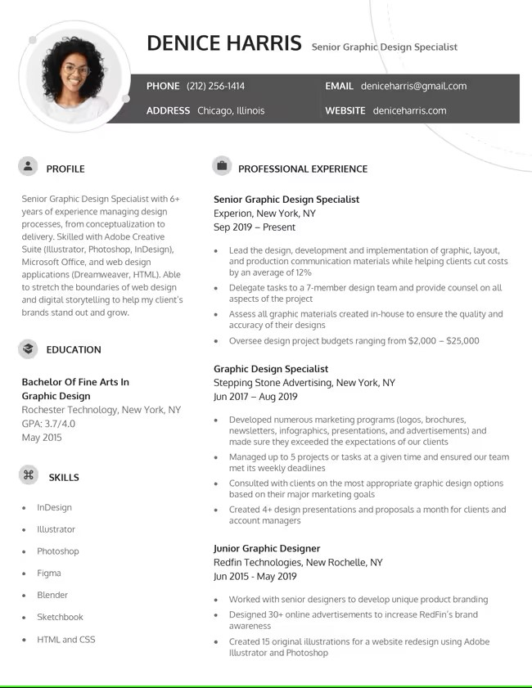
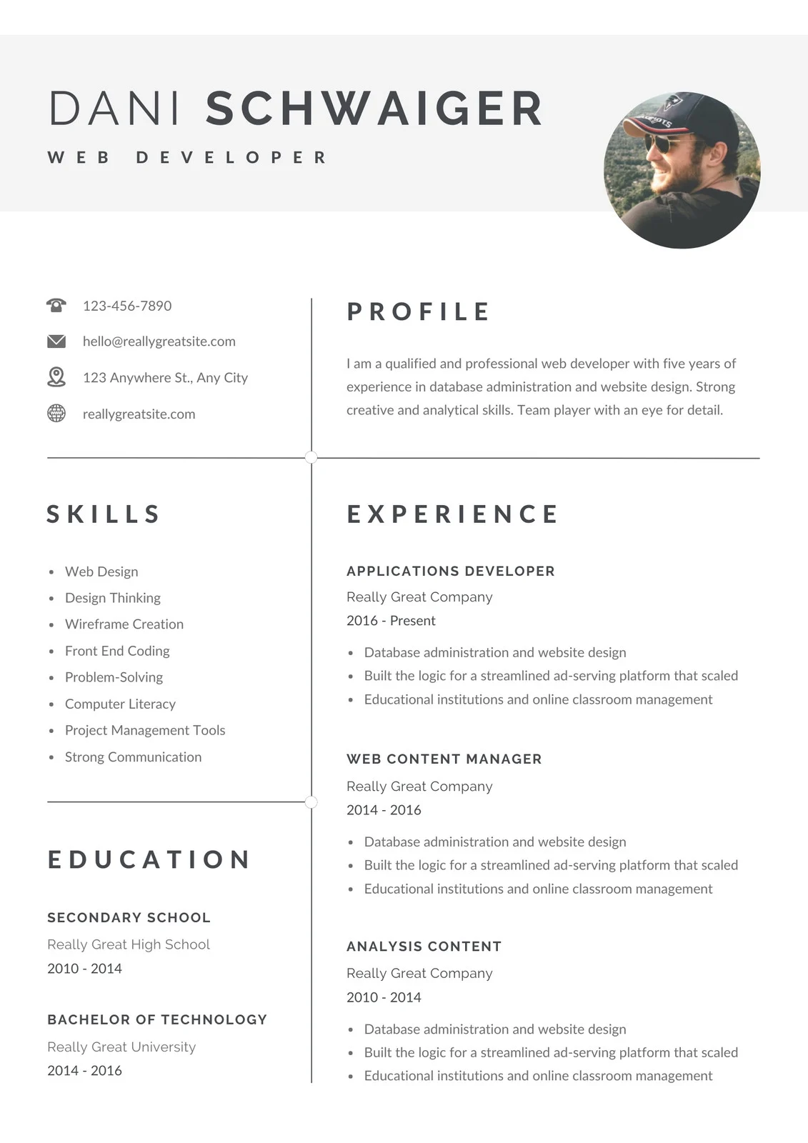
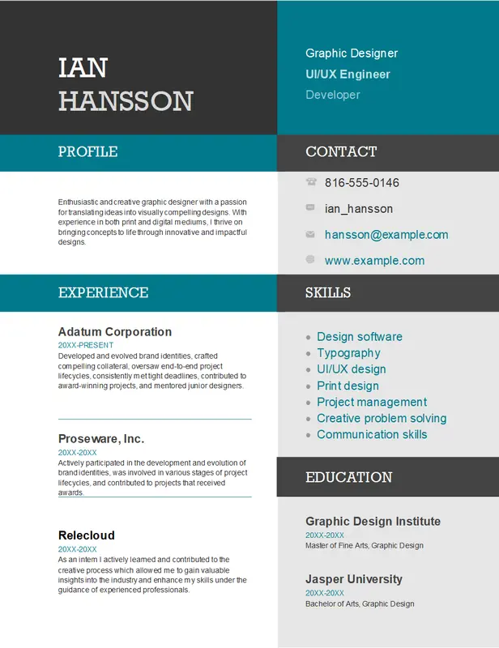
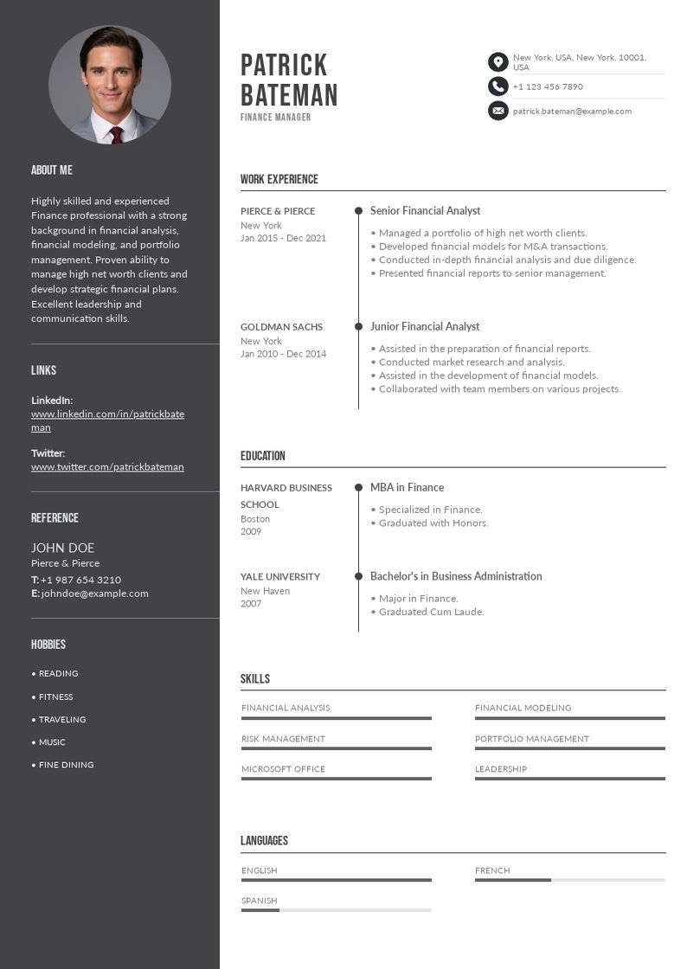

Slide 18
How to Formulate an Effective "About Me" or "Profile" Section
Purpose of the "About Me" or "Profile" Section
Provides a brief and impactful introduction to your professional persona.
Highlights key skills, career goals, and your value to potential employers.
Sets the tone for the rest of your CV or LinkedIn profile.
Structure of a Strong "About Me" Section
Who You Are: Start with your current role or career aspiration. Example: "Aspiring AI Specialist with a strong foundation in Python programming and machine learning."
Your Key Skills: Mention the most relevant skills for the job. Example: "Proficient in developing data-driven solutions using AI tools like TensorFlow and Scikit-learn."
Your Experience or Education: Include a brief note on relevant background or achievements. Example: "Completed an intensive AI bootcamp, building hands-on expertise in data processing and model deployment."
Your Goals: End with what you aim to achieve in the role or your contribution to the company. Example: "Looking to apply my skills to solve real-world problems and drive innovation in AI-driven solutions."

Slide 19
How to Formulate an Effective "About Me" or "Profile" Section
Tips for Writing the "About Me" Section
Be Concise: Keep it under 3-4 sentences.
Use Keywords: Incorporate terms relevant to the role (e.g., AI, data analysis, problem-solving).
Show Enthusiasm: Reflect your passion and interest in the field.
Tailor for the Job: Adjust the content to align with the job description.
Examples of Well-Written "About Me" Sections
"Junior AI Developer with a passion for creating efficient machine learning models. Proficient in Python, TensorFlow, and data visualization. Eager to contribute to innovative AI projects and drive impactful results.“
"Detail-oriented data scientist transitioning into AI development. Skilled in data processing, Python scripting, and building predictive models. Excited to collaborate in a dynamic team environment to solve complex challenges."

Slide 20
How to Formulate an Effective Cover Letter
Purpose of a Cover Letter
Introduces yourself and your qualifications to the employer.
Highlights why you are the best fit for the position.
Provides context for your CV, showcasing your personality and enthusiasm.
Tips for Crafting an Impressive Cover Letter
Personalize It: Tailor the content for each job application.
Show Enthusiasm: Let your passion for the role shine through.
Proofread: Ensure it’s free of errors in grammar and formatting.
Example of a Cover Letter Opening
"Dear [Hiring Manager's Name], As a recent graduate of [Bootcamp Name] specializing in Artificial Intelligence, I am excited to apply for the Junior AI Developer position at [Company Name]. My experience developing machine learning models and my strong foundation in Python align closely with the requirements for this role."

Slide 21
LinkedIn – not just a platform, but your gateway to professional growth, networking and career development
Professional Networking Platform
LinkedIn is the world’s largest professional network with over 900 million users globally.
It’s designed to connect professionals, companies, and recruiters in a virtual workspace.
Personal Branding Tool
Acts as your online resume and portfolio.
Showcases your skills, experiences, and achievements to potential employers.
Job Search Hub
Hosts job listings from companies across industries.
Allows you to apply directly to positions and connect with hiring managers.
Learning Resource
Offers LinkedIn Learning: courses on AI, data science, and other professional skills.
Helps you stay updated on industry trends through posts, articles, and news.
Networking Opportunities
Enables you to connect with colleagues, mentors, and recruiters.
Provides a platform to join industry-specific groups, such as AI and tech communities.
Visibility to Recruiters
Employers actively search for candidates on LinkedIn using filters like skills, location, and job titles.
Features like “Open to Work” help signal your availability for opportunities.

Slide 22
LinkedIn Profile Completion Guide and Functionalities
LinkedIn Profile Structure
Profile Photo and Background Image:
Use a professional, high-resolution headshot.
Add a background image relevant to your field (e.g., AI, technology, or innovation).
Headline:
Clearly state your role or aspiration, e.g., "Aspiring AI Specialist | Junior Python Developer | Continuous Learner."
About Section:
Write a compelling summary of your skills, experiences, and career goals. Use keywords relevant to AI (e.g., machine learning, Python, data analysis).
Experience:
List previous roles with concise descriptions of responsibilities and achievements. Highlight transferable skills and AI-related projects.
Education:
Include formal education, online courses, certifications, and bootcamps relevant to AI.
Skills and Endorsements:
Add relevant skills such as Python, TensorFlow, and problem-solving. Encourage colleagues to endorse them.
Projects:
Showcase key AI-related projects with brief descriptions, technologies used, and outcomes.
Recommendations:
Request written recommendations from mentors or colleagues that highlight your technical and soft skills.
Accomplishments:
Include publications, honors, or additional certifications.

Slide 23
LinkedIn Profile Completion Guide and Functionalities
LinkedIn Functionalities
Connections:
Connect with peers, professionals, and recruiters in the AI field.
Posts and Articles:
Share insights, AI-related news, or personal projects to demonstrate engagement in the field
.
LinkedIn Learning:
Access courses to continually update skills (e.g., machine learning, NLP, or SQL).
Job Search:
Use job filters to find roles tailored to your expertise. Set up alerts for AI-related positions.
Networking:
Join LinkedIn Groups focused on AI, data science, or technology to stay updated and build relationships.
Open to Work:
Activate the “Open to Work” badge to let recruiters know you’re seeking opportunities.
Analytics:
Monitor profile views and search appearances to evaluate your visibility.
.

Slide 24
LinkedIn Profile Completion Guide and Functionalities
LinkedIn Profile Tips
Personalization: Tailor your profile to your AI aspirations by using relevant keywords throughout.
Engagement: Regularly interact with posts and articles to stay active in the AI community.
Consistency: Align your LinkedIn profile with your CV and other professional documents.

Slide 25
Job Searching Tips and Platforms for Junior AI Roles
1. Keywords for Job Search
KEYWORDS
Use these keywords to find relevant opportunities:
Junior AI Specialist
AI Developer
Machine Learning Intern/Junior
Data Science Intern/Junior
Artificial Intelligence Trainee
Junior Data Analyst
Junior NLP Engineer
Deep Learning Intern
AI Research Assistant
Entry-Level AI Engineer

Slide 26
Job Searching Tips and Platforms for Junior AI Roles
1. Keywords for Job Search
Recruitment Platforms in Romania
Explore these platforms for job opportunities:
LinkedIn:
Search for jobs and connect with recruiters.
Follow companies like UiPath, Endava, or NTT Data Romania.
Hipo.ro:
Focused on entry-level and junior roles.
BestJobs.eu:
Regularly features AI and IT-related positions.
eJobs.ro:
Offers a variety of listings in tech and AI fields.
SmartDreamers:
Specialized platform for tech and digital roles.
Glassdoor and Indeed:
For company reviews and AI job listings.

Slide 27
Job Searching Tips and Platforms for Junior AI Roles
1. Keywords for Job Search
Tips for Effective Job Searching
Set Alerts: Create job alerts using keywords like “AI Junior” or “Machine Learning Intern”.
Network: Attend local AI meetups or online webinars to connect with professionals.
Portfolio: Include your GitHub or Kaggle profile with AI projects.
Tailor Applications: Customize your CV and cover letter for each job.

Slide 28
Tips for Managing Recruitment Processes as a Candidate
1. Understand the Recruitment Stages
Understand the Recruitment Stages
Familiarize yourself with the typical steps in a recruitment process:
Application Submission: Tailor your CV and cover letter for each role.
Screening: Be ready for online assessments or phone interviews.
Interview Rounds: Expect technical, behavioral, and cultural fit evaluations.
Offer Negotiation: Know your value and be prepared to negotiate salary and benefits.
Research the Company
Visit the company’s website and LinkedIn page.
Understand their mission, values, and recent achievements.
Familiarize yourself with their products or services and identify how your skills align.
3. Prepare for Interviews
Technical Interviews: Practice coding challenges, problem-solving tasks, or case studies relevant to the role.
Behavioral Interviews: Use the STAR method (Situation, Task, Action, Result) to structure answers.
Cultural Fit Interviews: Show enthusiasm for the company and demonstrate alignment with its values.

Slide 29
Tips for Managing Recruitment Processes as a Candidate
1. Maintain Professional Communication
Respond promptly to recruiter emails or messages.
Use formal and polite language in all interactions.
Ask questions to show interest and clarify expectations.
Stay Organized
Keep a record of job applications, deadlines, and interview dates.
Use tools like Trello or a simple spreadsheet to track progress.
Demonstrate Enthusiasm
Show genuine interest in the role during interviews.
Highlight how the position aligns with your career goals and aspirations.
Handle Rejection Gracefully
If rejected, politely thank the recruiter for the opportunity.
Request feedback to improve your performance in future applications.

Slide 30
Tips for Managing Recruitment Processes as a Candidate
Follow Up
After interviews, send a thank-you email to express appreciation for the opportunity.
Reaffirm your interest in the position and highlight key points from the discussion.
Be Patient but Proactive
Allow recruiters sufficient time to respond.
If you haven’t heard back within a week or two, follow up politely.
Leverage LinkedIn
Stay active by posting about your learning journey or projects.
Connect with recruiters or employees from companies you’re applying to.
Join relevant LinkedIn groups to expand your network.

Slide 31
HR Questions for Junior AI Candidates with Suggested Responses
General Background Questions
Can you tell us about yourself and why you’re interested in AI? Suggested Answer: "I recently transitioned into AI after completing a certification program. My background in [field] has given me strong problem-solving skills, and I’ve always been fascinated by how AI can solve real-world challenges. I’m excited to contribute to projects that use AI to make an impact."
What inspired you to transition into a career in AI? Suggested Answer: "I’ve always been passionate about technology, and seeing how AI is revolutionizing industries inspired me to pursue this path. My interest grew as I started working on small projects, like building a chatbot, which reinforced my decision."
How do you think your previous experiences have prepared you for this role? Suggested Answer: "In my previous roles, I honed transferable skills like data analysis, problem-solving, and teamwork. These are directly applicable to AI development, especially when working with datasets and collaborating on technical projects."
Teamwork and Collaboration
Have you worked in a team to solve a technical problem? Can you describe the experience? Suggested Answer: "Yes, during my AI course, we collaborated on a project to build a predictive model for customer behavior. I was responsible for data cleaning and analysis, and we worked closely to integrate our parts. It was a valuable experience in teamwork and communication."
How do you handle disagreements or conflicts in a team environment? Suggested Answer: "I believe in active listening and addressing concerns openly. In one instance, during a group project, there was a disagreement on the approach. I suggested we test both ideas on a small scale and evaluate based on results, which resolved the conflict effectively."

Slide 32
HR Questions for Junior AI Candidates with Suggested Responses
Problem-Solving and Critical Thinking
Describe a situation where you faced a challenge in learning a new concept or tool. How did you overcome it? Suggested Answer: "When I started learning machine learning algorithms, I found neural networks particularly challenging. I dedicated extra time to studying online tutorials and practicing small projects. Breaking the concept into smaller parts helped me understand it better."
How do you approach solving a problem when the solution isn’t immediately clear? Suggested Answer: "I start by analyzing the problem and breaking it into smaller, manageable tasks. I then research potential solutions and, if needed, consult with teammates or mentors to brainstorm ideas. Testing and iterating are key parts of my problem-solving process."
Time Management and Adaptability
How do you prioritize tasks when working on multiple projects with tight deadlines? Suggested Answer: "I list all tasks and prioritize them based on deadlines and importance. I also set realistic time blocks for each task and check progress daily. Tools like Trello or Asana help me stay organized."
Tell us about a time when you had to adapt to a significant change. How did you manage it? Suggested Answer: "During my AI training, our final project scope changed mid-way. I adapted by reevaluating priorities and quickly learning the new tools required. Flexibility and clear communication with my team were essential."

Slide 33
HR Questions for Junior AI Candidates with Suggested Responses
Learning and Growth
What steps have you taken recently to improve your technical or AI-related skills? Suggested Answer: "I’ve completed online courses on TensorFlow and participated in Kaggle competitions. I also work on small AI projects, such as a movie recommendation system, to apply what I’ve learned."
Can you share a project or personal initiative that reflects your commitment to continuous learning? Suggested Answer: "I built a simple chatbot for customer support using Python and NLP libraries. It started as a learning exercise but turned into a portfolio project that demonstrates my technical growth."
Motivation and Goals
What are your short-term and long-term career goals in AI? Suggested Answer: "Short-term, I want to build a strong foundation by contributing to real-world AI projects and learning from experienced team members. Long-term, I aspire to specialize in areas like NLP or computer vision and eventually mentor others in the field."
How do you define success in your career? Suggested Answer: "Success for me means continuous growth, delivering impactful AI solutions, and being a collaborative and reliable team member who contributes to the organization’s goals."

Slide 34
HR Questions for Junior AI Candidates with Suggested Responses
Ethics in AI
How do you think ethical considerations should influence AI development? Suggested Answer: "Ethical considerations are critical in AI to ensure fairness, transparency, and accountability. Developers must mitigate biases in datasets and models while designing solutions that benefit society responsibly."
What do you think are the biggest challenges related to AI and ethics? Suggested Answer: "I believe the biggest challenges are bias in data, lack of transparency in decision-making processes, and ensuring privacy. Addressing these requires clear guidelines and collaboration between technical and ethical experts."

Slide 35
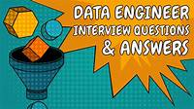
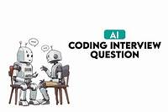

Technical Questions for Junior AI Candidates with Suggested Responses
365 Data Science Offers a comprehensive list of AI engineer interview questions, covering various aspects of AI engineering principles, machine learning, and neural network
Turing Provides a curated list of 100 AI interview questions and answers, ranging from basic to advanced levels, suitable for candidates preparing for AI roles.
Adaface Features a collection of 60 AI interview questions, categorized by difficulty and topic, including machine learning algorithms and neural networks.
GeeksforGeeks Offers a comprehensive guide on the top 50 AI interview questions and answers, covering key AI topics essential for interviews.
DigitalDefynd Provides a list of 50 AI engineer interview questions and answers, covering various aspects of AI engineering, including machine learning, deep learning, and natural language processing.

Slide 36
Final Tips for Success
Stay Resilient
Be Proactive
Customize Your Application
Prepare Thoroughly!
Customize Your Application
Leverage Your Network
Embrace Feedback
Showcase Your Passion
"The road to success is built on persistence, preparation, and passion. Keep learning, growing, and striving toward your dreams!"

Slide 37
A Final Thought…
Embarking on a career in AI is a journey filled with opportunities to innovate and make a meaningful impact. By leveraging your transferable skills, continuously learning, and staying adaptable, you can navigate the challenges of this dynamic field and thrive as a professional. Remember, each step—whether it's crafting your CV, acing interviews, or building your expertise—brings you closer to achieving your goals. Believe in your potential, stay curious, and embrace the future of AI with confidence!
Thank you,
Alina Niculae
SDA Career Advisor
a.niculae@sdacademy.ro

Slide 38



Thank you for your attention
a.niculae@sdacademy.ro
+0374 349 900
Software Development Academy Romania
@sdaromania

